Slide 1

2025 Workforce Alliance
Board of Directors
Work Plan and Goals
March 12, 2025

Slide 2

Leveraged Funds

Slide 3
2025 Work Plan and Goals
Throughline: Economic Mobility
Primary Focus Areas:
Youth Employment (At-Risk, Barrier Reduction)
Veterans Employment (Home Base Wichita)
Justice Involved Individuals (Fair Chance, local priority)
Transitioning Workers (lay-offs, growth of emerging companies / sectors, digital literacy)
Employer Partners

Slide 4
2025 Board of Directors Work Plan
Invite/Host Senators Moran and Marshall, and Representative Estes to visit the Workforce Center
Establish series of “lunch and learn” sessions held at the Wichita Workforce Center, and with partners in the region, to expand employer partnerships
Develop and approve the 2026-2028 Workforce Alliance Strategic Goals

Slide 5
2025 Board of Directors Work Plan
Raise $50,000 at the 2025 Jobs FORE Youth Golf Tournament
Define / Measure Board Member support and participation
  Employer Partner
    Job postings
    Job fairs
    Pre-screening
    On the Job Training / RA
    Youth Employment
  Strategic Funder
    Jobs FORE Youth
    Camp HYPE
    Matching funds for grants
    Special Projects

Slide 6

Youth Employment Project (YEP)
The Youth Employment Project (YEP) is an initiative to assist young adults in finding a first job or work experience opportunity. Services through YEP include assistance in resume creation, job search, preparing for interviews as well as education on soft skills, customer service and financial literacy.
Summer High School Internships
CAMP HYPE Sessions
Summer Jobs and Youth Focused Job Fairs

Slide 7
EPA Brownfields Jobs Training Grant
The WA is receiving $499,734.81 to support 90 participants over 24 months.
Participant Training Costs: $298,150 for training tuition to support 90 participants in environmental credential or licensure programs.
Participants Support Costs: Include $16,000 for transportation, childcare, housing, or other items necessary to enable individuals to participate and complete training activities.
Estimated Average Wage for Participants completing Training $21.99 per hour

Slide 8


Home Base Wichita
HOME BASE WICHITA SEEKS TO RETAIN, REGAIN AND ATTRACT
MILITARY-CONNECTED TALENT

Slide 9
Home Base Wichita
Accelerated AirFrame & Power (A&P) Program.
For transitioning service members and veteranswho have A&P training through the military, they will now be able to enroll in an accelerated A&P program that will take 6 weeks, rather than the traditional 2-year program, and cost $4,400.00.
The WA, through the One Workforce grant will fund scholarships for those that meet eligibility.

Slide 10
Home Base Wichita
Accelerated AirFrame & Power (A&P) Program.
Key Partners
Heroes Make America / Manufacturing Institute
Textron Aviation
McConnell Air Force Base
WSU Tech

Slide 11
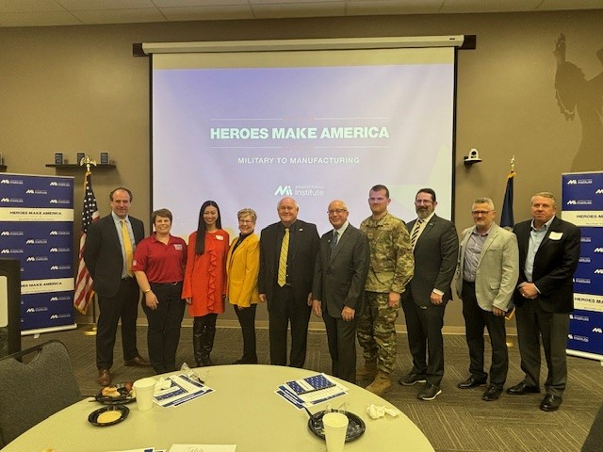
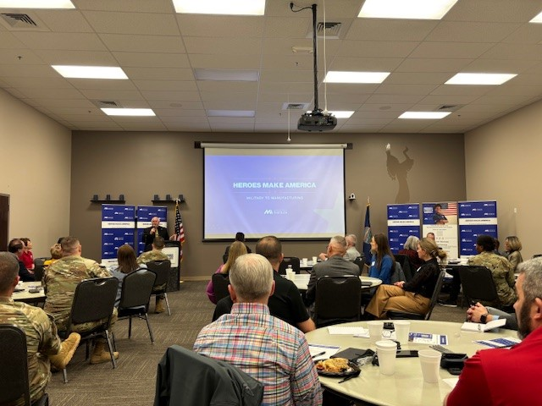
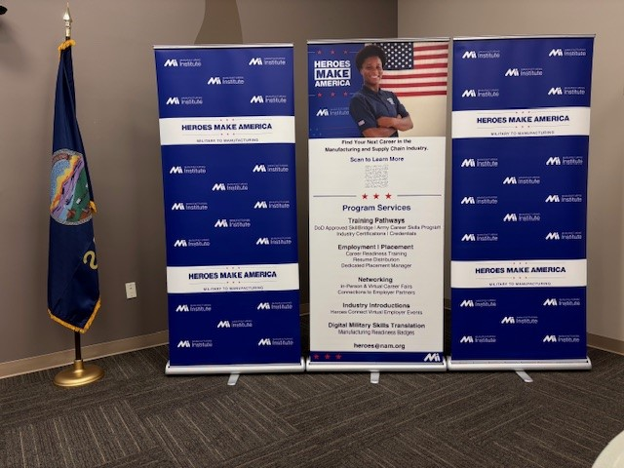
Home Base Wichita
The Workforce Alliance hosted a kick-off lunch and learn on March 7, 2025

Slide 12
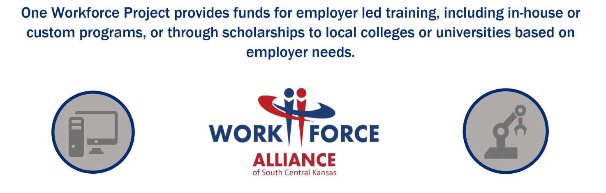

One Workforce Grant
N
$6,ooo per Eligible Employee
Advanced Manufacturing
or
IT/Computer Science Occupations

Slide 13
One Workforce Grant – Employer Partners
Aerospace Turbine Rotables
Aero-Tech Engineering
Airbus Americas
ANR Leasing
Bombardier
Center Industries Corp.
CMJ Manufacturing Inc.
Cox Machine
Creekstone Farms
Ember Audio Visual
Etezazi Industries
Fiber Dynamics
Global Aviation Technologies
Hall Industrial Services
Harlow Aerostructures
Harper Industries
High Tough Technologies
HM Dunn Aerosystems
IdeaTek Telcom
Integra
JR Custom Metal Products
Keycentrix
Lawn Buddy
Metal Finishing Company

Slide 14
One Workforce Grant – Employer Partners
Midwest Hemp Technology
Milling Precision Tool Corp
Net Ability
NIAR
Novacoast
NovaSoc
Omni Aerospace
PB Hoidale Co.
SnapIT Solutions
Spirit AeroSystems
Student Startup
TEC Systems
Textron Aviation
The Bradbury Company
USIC
Vermillion Incorporated
Youngers and Sons

