Slide 1
2025 Workforce Alliance
Board of Directors
Work Plan and Goals
January 8, 2024

Slide 2
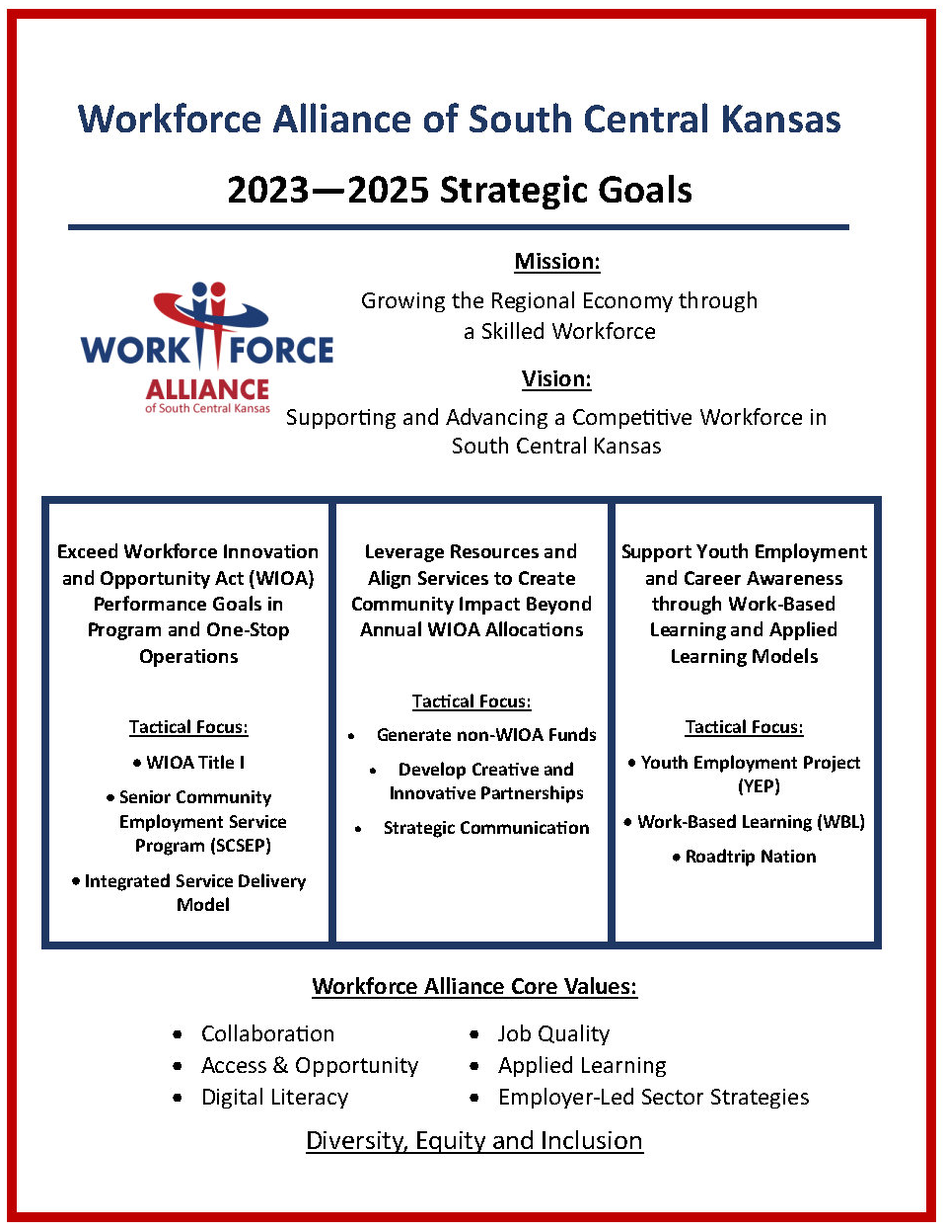
Leveraged Funds

Slide 3
2025 Work Plan and Goals Throughline: Economic Mobility
Primary Focus Areas:
Youth Employment (At-Risk, Barrier Reduction)
Veterans Employment (Home Base Wichita)
Justice Involved Individuals (Fair Chance, local priority)
Transitioning Workers (lay-offs, growth of emerging companies / sectors)
Employer Partners

Slide 4
2025 Board of Directors Work Plan
Invite/Host Senators Moran and Marshall, and Representative Estes to visit the Workforce Center
Establish series of “lunch and learn” sessions held at the Wichita Workforce Center, and with partners in the region, to expand employer partnerships.
Develop and approve the 2026-2028 Workforce Alliance Strategic Goals

Slide 5
2025 Board of Directors Work Plan
Raise $50,000 at the 2025 Jobs FORE Youth Golf Tournament
Define / Measure Board Member support and participation
Employer Partner
Job postings
Job fairs
Pre-screening
On the Job Training / RA
Youth Employment
Strategic Funder
Jobs FORE Youth
Camp HYPE
Matching funds for grants
Special Projects

Slide 6
Home Base Wichita
HOME BASE WICHITA SEEKS TO RETAIN, REGAIN AND ATTRACT
MILITARY-CONNECTED TALENT

Slide 7
One Workforce Grant
N
$6,ooo per Eligible Employee
Advanced Manufacturing
or
IT/Computer Science Occupations

Slide 8
Youth Employment Project (YEP)
The Youth Employment Project (YEP) is an initiative to assist young adults in finding a first job or work experience opportunity. Services through YEP include assistance in resume creation, job search, preparing for interviews as well as education on soft skills, customer service and financial literacy.
The Workforce Alliance initiated a youth employment strategy in 2009
Recognized Declining Teen Employment Rates
Strategy to Develop “Soft Skills”
Research of best practices included two key elements
Engagement of Business Community
Connecting Summer Jobs to Academic Interest and Programs

Slide 9
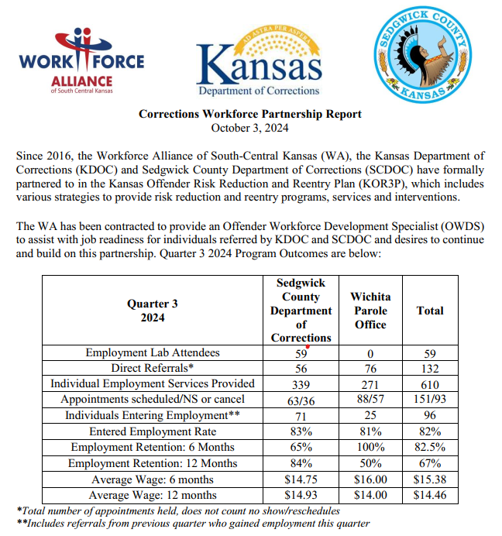
Fair Chance (Justice Involved Individuals)

Slide 10
2025 Board of Directors Work Plan
Next Steps:
Executive Committee Review and Discussion
Recommendation for adoption by the Workforce Alliance Board on January 22
Other suggestions???

