Slide 2
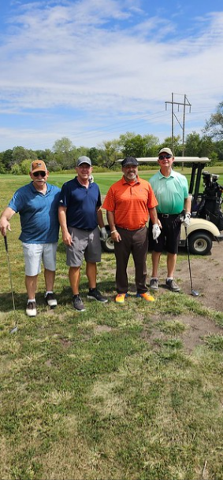
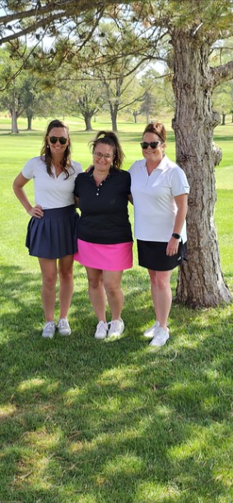
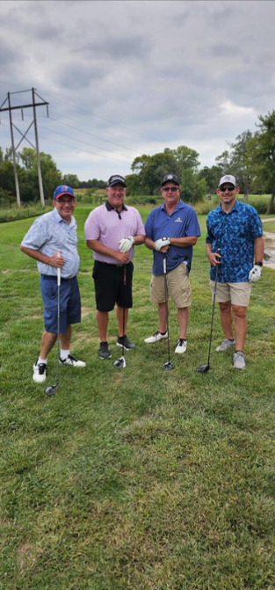
IT’S TIME ONCE AGAIN FOR THE ANNUAL
JOBS FORE YOUTH
GOLF TOURNAMENT !

Slide 3
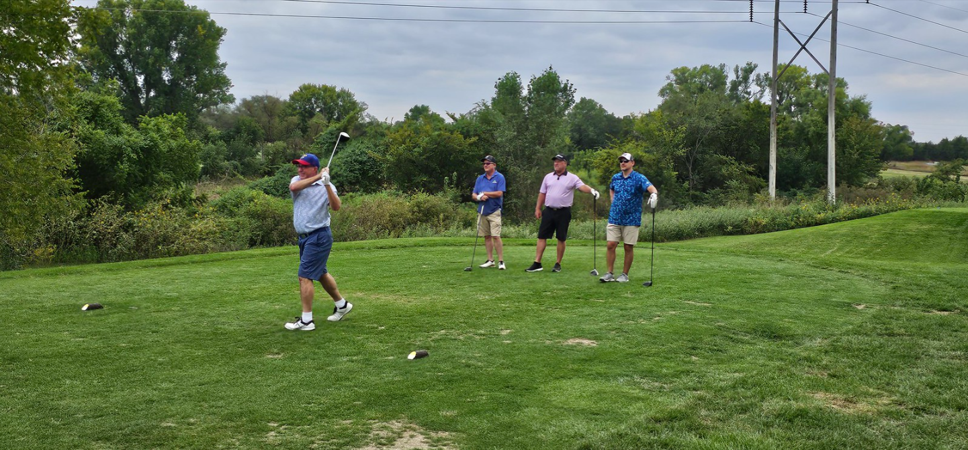
Hit the links while helping local area youth

Slide 4
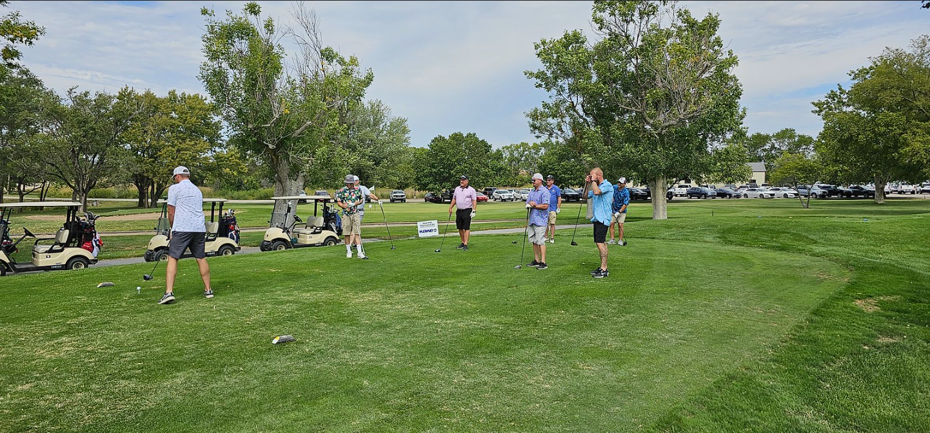
Proceeds benefit the Youth Employment Project
and provide a first job for young job seekers

Slide 5
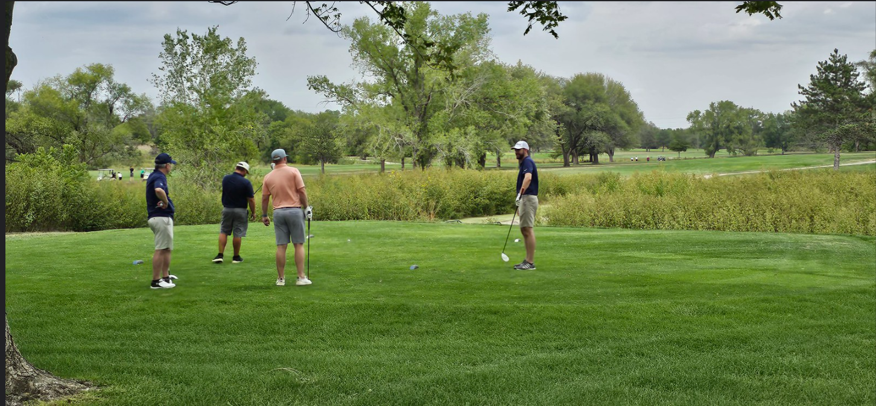
Enter your team and enjoy a round of golf at beautiful Hidden Lakes Golf course, paired with lunch, drinks, pizza, and prizes.

Slide 6
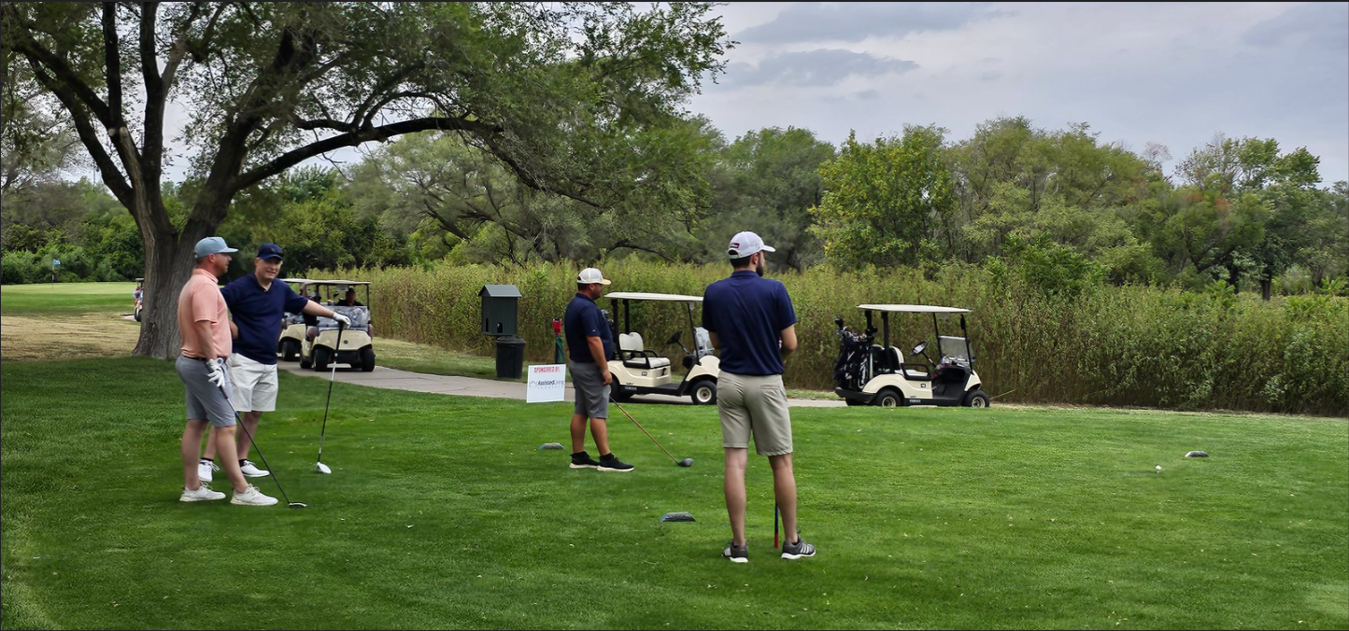

Slide 7
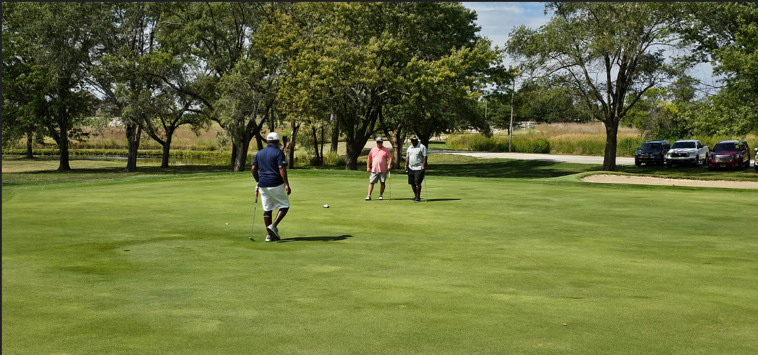
Can’t make the tournament on Sep. 19?
Sponsors are still needed to help further youth employment in the local area!

Slide 8
THANK YOU TO OUR CURRENT SPONSORS

Slide 11
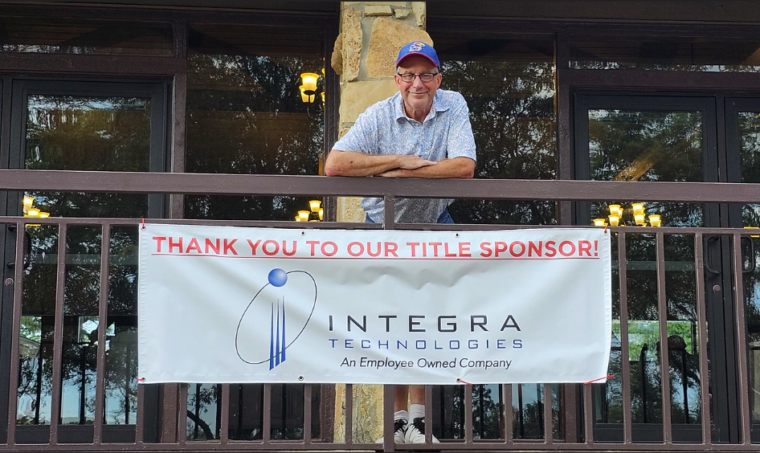

Slide 12
ENTER A TEAM, BE A SPONSOR, LEARN MORE

