Slide 1
FACT:
Each year approximately 200,000 members of the U.S. Armed Forces, stationed in over 140 military installations in the U.S. and overseas, will leave active duty and re-enter the civilian work force or pursue higher education

Slide 2
Veterans ICT Initiative
Elevating your talent pipeline needs by engaging:
Veterans
Transitioning active-duty services members
Reserve and National Guard service members
Military spouses
Student veterans

Slide 3
Veterans ICT Initiative
Military and veteran hiring best practices
Retention plans
Skills matching
Labor force identification
Connection to military sourcing programs

Slide 4
Additional Offerings
Understanding Military Culture and the Six Branches
Deciphering the Veteran Interview
Veteran Retention and Career Advancement
Military Leadership Guide
Semi-annual networking events
One-on-One Coaching
Notes:
Understanding Military Culture and the Six Forces
How those skills unique to each branch translate into jobs, careers, and leadership positions at your company
Deciphering the veteran interview: How to interpret the body language, unique military language, and what not to say.
The importance of career advancement: Research shows 43% of veterans leave their first civilian job within the first year, and 80% leave before the end of their second year, citing a lack of opportunity for career advancement and personal development. This workshop details the importance of planning your veterans success plan from the first day of employment as your best means to retaining the talent.
Military Leadership Guide: Understanding the ranks, the types of leadership at each levels. What does “Commanders Intent” mean, and what does Oath of Enlistment and the Oath of Office mean.
Semi-annual networking events: twice per year, we invite transitioning military, National Guard and reservists, and spouses to a networking event. This is your opportunity to get one-on-one facetime with several potential skilled hires at one time, and to showcase your company’s culture. The military-connected individuals have the opportunity to showcase themselves and to get in front of multiple companies in one fell swoop. Similar to a job fair, but without the need or expectation to make immediate-hire offers. It’s your opportunity to peruse talent and fit.

Slide 5
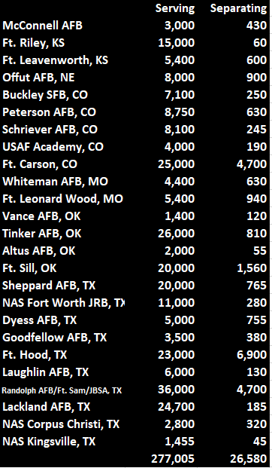
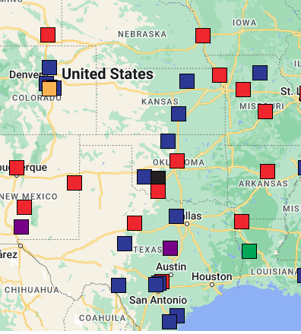
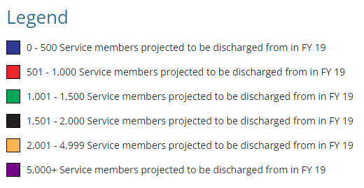
Notes:
S

Slide 6
According to the 2020 Student Veteran Association Census, most transitioning service members don’t seek work similar to their military careers.
Source: https://studentveterans.org/wp-content/uploads/2021/04/SVA-Census-2020-Report.pdf

